Slide 1

Probability distributions
DATA ANALYTICS | IRONHACK

Slide 2

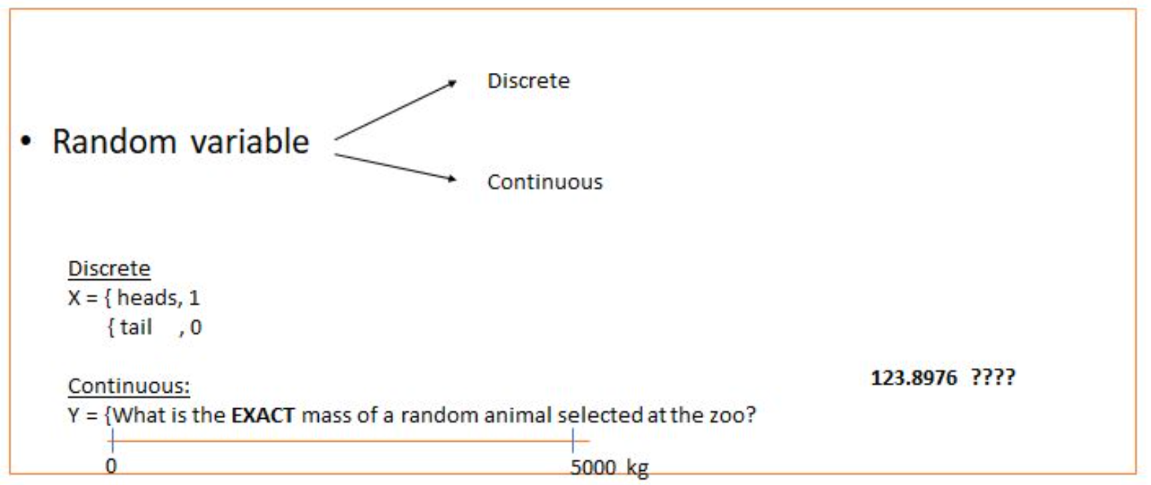
IRONHACK BOOTCAMP
RANDOM VARIABLES:

Slide 3
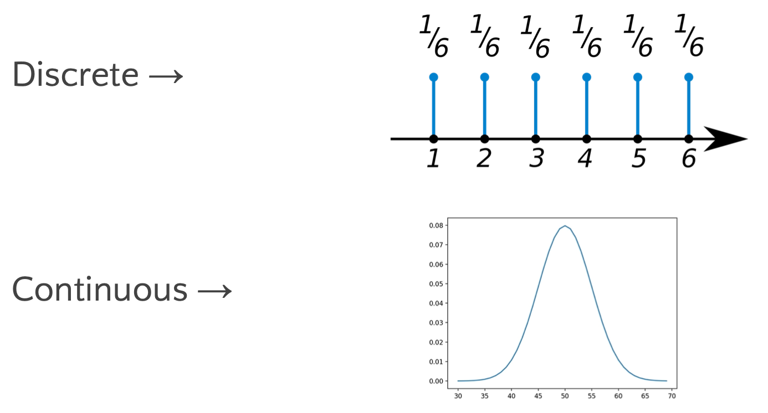
IRONHACK BOOTCAMP
PROBABILITY DISTRIBUTIONS:
Mathematical function that gives us the probabilities of occurrence of different outcomes.

Slide 4
IRONHACK BOOTCAMP
PMF: PROBABILITY MASS FUNCTION (DISCRETE)
Is a function that give us the probability that a DISCRETE random variable takes an specific value

Slide 5
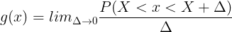
IRONHACK BOOTCAMP
PDF: PROBABILITY DENSITY FUNCTION (CONTINUOUS)
The PDF is the equivalent of PMF but for continuous variables.
As you can have an infinite amount of possible values between any two numbers, is not possible to define the probability for every value.
Therefore, we define a density of probability rather than the probability mass. The concept is very similar to mass density in physics: its unit is probability per unit length. To get a feeling for PDF, consider a continuous random variable X

Slide 6
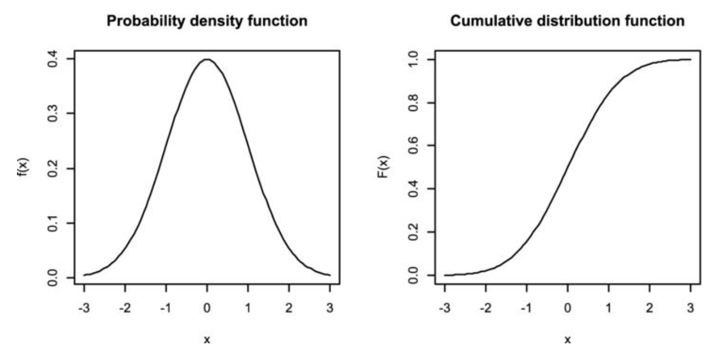
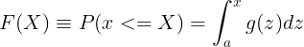
IRONHACK BOOTCAMP
CDF: CUMULATIVE DISTRIBUTION FUNCTION
The CDF is a function that gives the probability of getting any value smaller or equal to a given value:
How much probability we will have if we add probabilities until a given value?

Slide 7

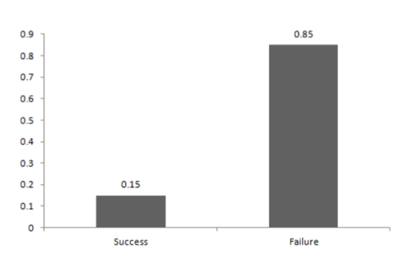
IRONHACK BOOTCAMP
DISCRETE DISTRIBUTIONS: BERNOULLI DISTRIBUTION
A Bernoulli event is one for which the probability the event occurs is p and the probability the event does not occur is 1-p; i.e., the event only has two possible outcomes (usually viewed as success or failure) occurring with probability p and 1-p, respectively

Slide 8
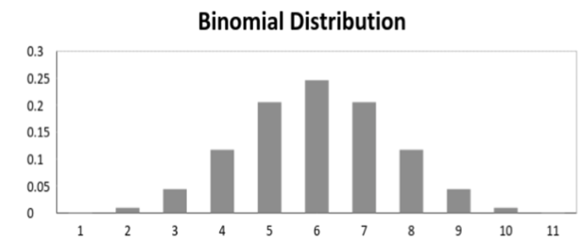
IRONHACK BOOTCAMP
DISCRETE DISTRIBUTIONS: BINOMIAL DISTRIBUTION
When ”n” independent Bernoulli's experiments are conducted, it gives rise to a binomial distribution. Each of the n experiments is either a success or a failure with a probability of success p.
coin launched n times example with x heads.

Slide 9
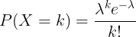
IRONHACK BOOTCAMP
DISCRETE DISTRIBUTIONS: POISSON DISTRIBUTION
The Poisson distribution is used when computing the probability of a k number (integer value [0, ∞]) of events ( counts ), and it’s given by:
In general the Poisson distribution for DISCRETE variables
The possible number of outcomes is unlimited! (Binomial only has a finite amount of possible outcomes).
Is used when we model counting events that can have any values:
Cars arriving a toll per hour
Clients on a cashier queue per hour.

Slide 10
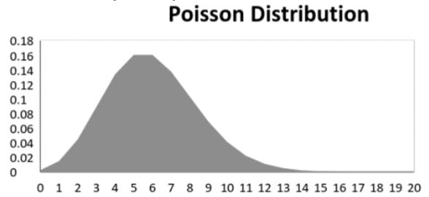
IRONHACK BOOTCAMP
DISCRETE DISTRIBUTIONS: POISSON DISTRIBUTION
The Poisson distribution is used when computing the probability of a k n

Slide 11
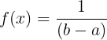
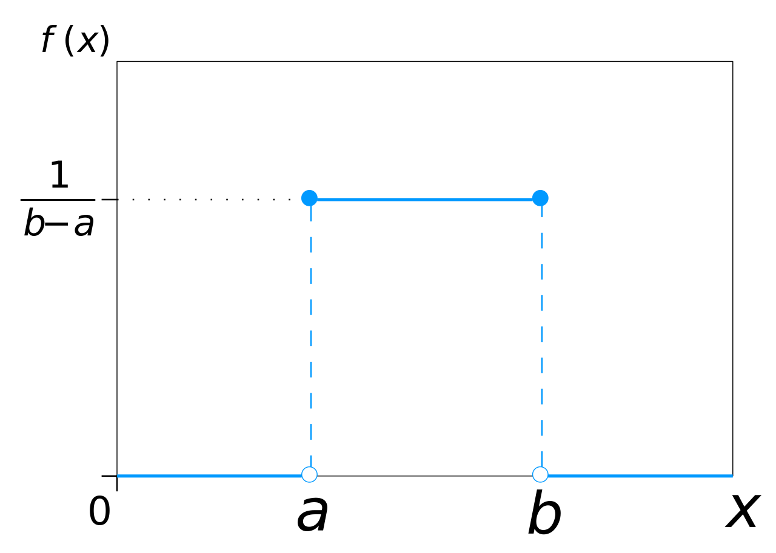
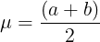
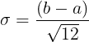
IRONHACK BOOTCAMP
CONTINUOUS DISTRIBUTIONS: UNIFORM DISTRIBUTION
For this distribution, all the values have the same probability to appear.
The uniform distribution is characterized by being constant:

Slide 12
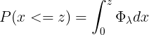
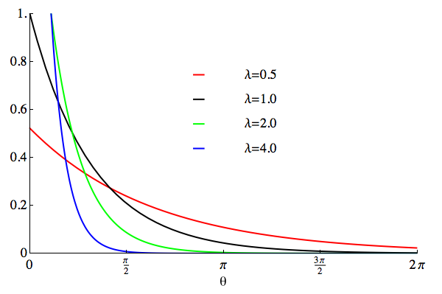
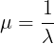
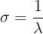
IRONHACK BOOTCAMP
CONTINUOUS DISTRIBUTIONS: EXPONENTIAL DISTRIBUTION
The exponential distribution has the following pdf:
It has the following range of values: [0,inf)

Slide 13
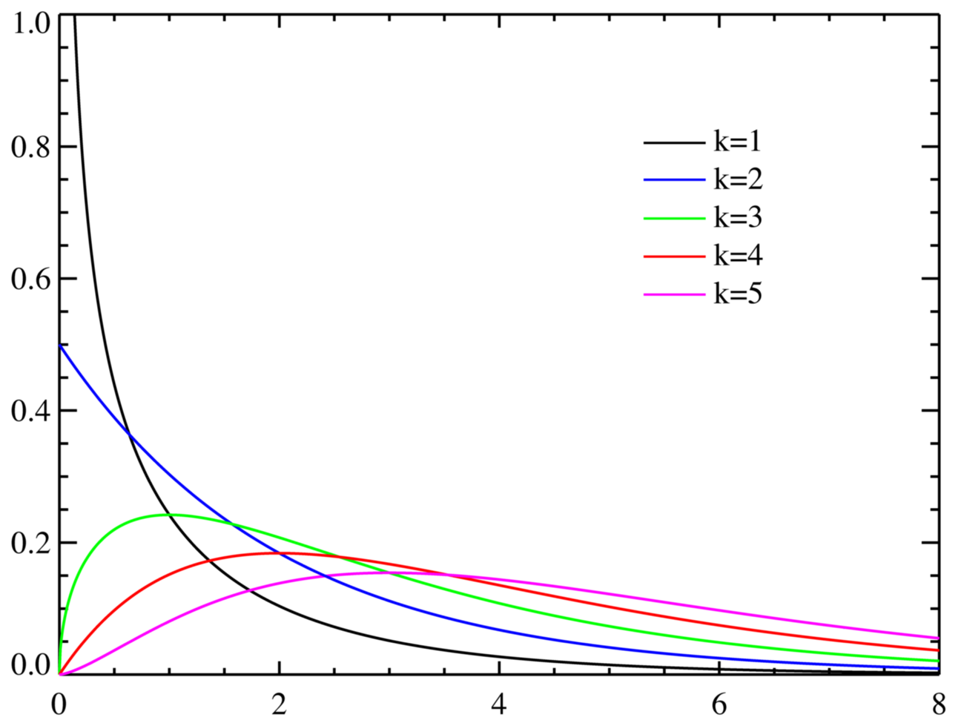
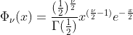
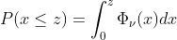
IRONHACK BOOTCAMP
CHI2 DISTRIBUTION
It has the following range of values: [0,inf)

Slide 14
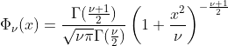
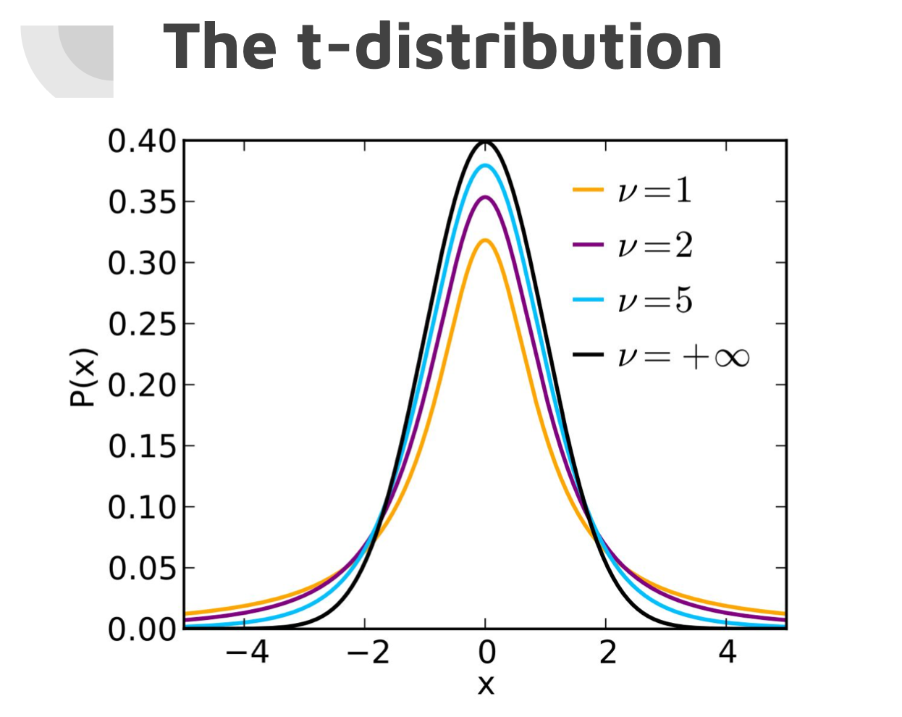
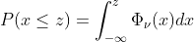
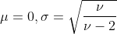
IRONHACK BOOTCAMP
T-STUDENT DISTRIBUTION

Slide 15
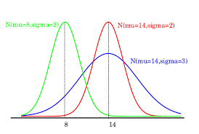
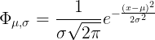
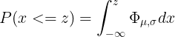
IRONHACK BOOTCAMP
NORMAL DISTRIBUTION
The normal distribution is characterized by the mean and the standard deviation.
X can take values from (-inf,inf)

Slide 16

IRONHACK BOOTCAMP
PROBABILITIES IN PYTHON: SCIPY
Scipy library contains the module ‘stats’ which allows you to compute probabilities, PDF, CDF,....for several distributions.
Official documentation
scipy.stats.norm.pmf()
scipy.stats.norm.ppf() -> what is the value on the x-axis which corresponds to a given area under the curve
scipy.stats.norm.cdf() ->
scipy.stats.expon.pmf()
Every distribution has his own pmf() function in scipy.

Slide 17


